Slide 1
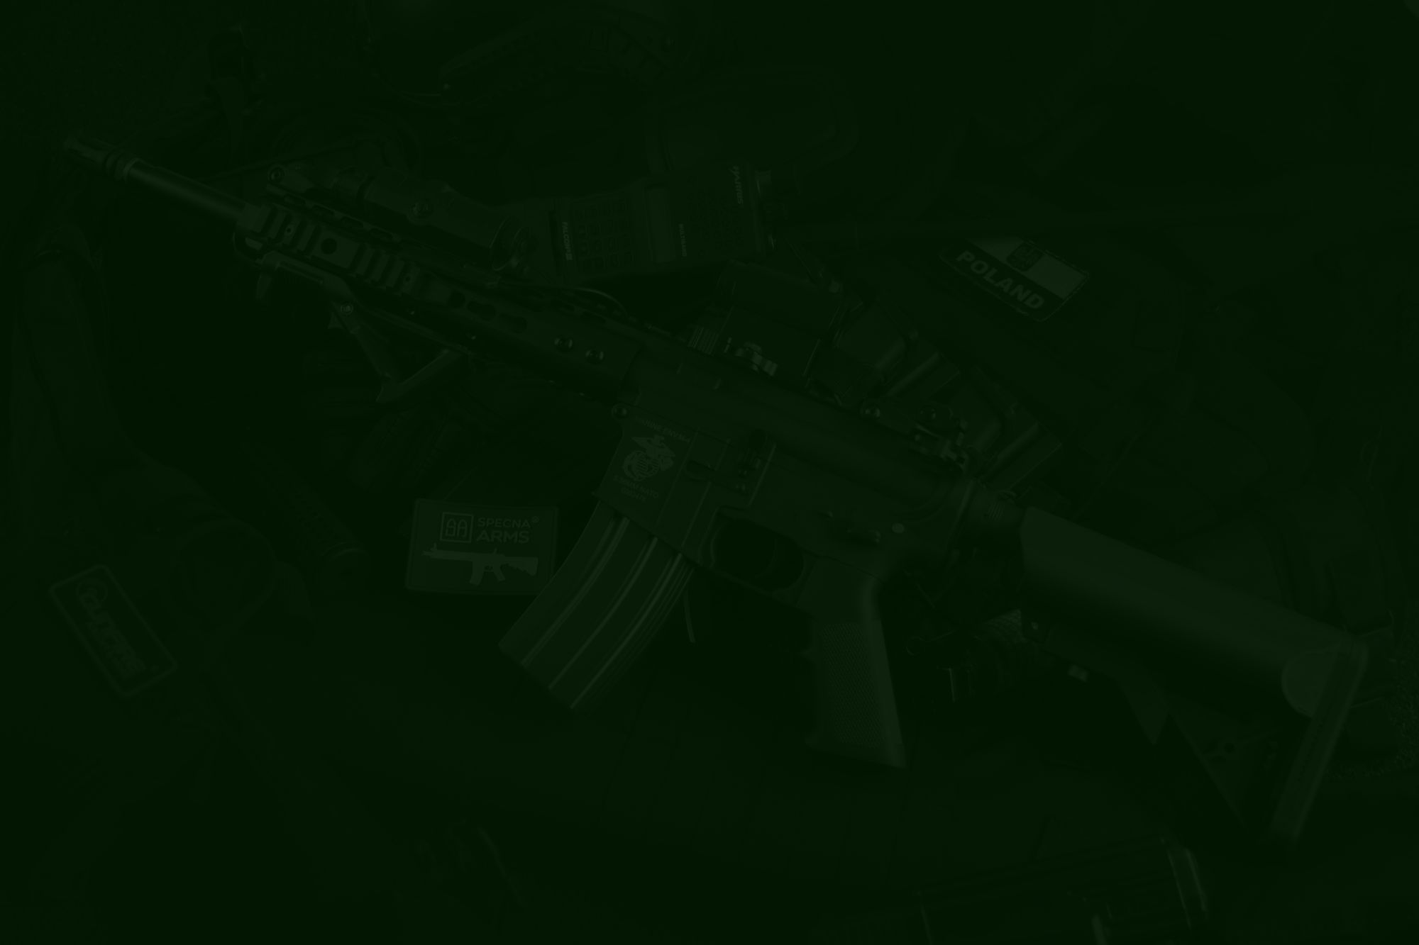
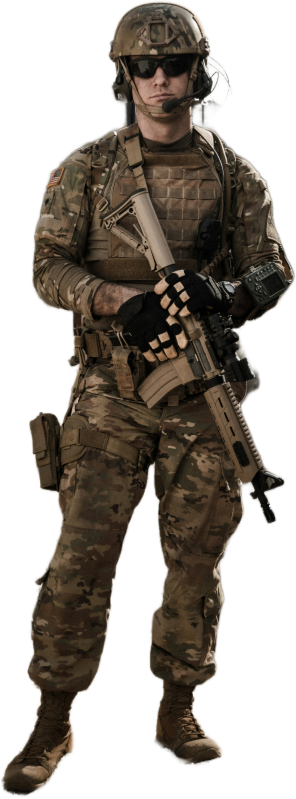
NexTech 1.0
Team Name :
Code Commandos
Problem Statement Title :
“The Challenge of Silent Communication in Stealth Missions and critical situations. ”
Team Leader Name :
Rimjhim Kumari
Institute Name :
Odisha University of Technology and Research(OUTR)
Team Lead Contact Number:
8328977957
Team Member’s Name:
Rimjhim Kumari , Asutosh Sahoo, Debasish Dash , Jyoti Prakash Samal , Sonalika Jena .

Slide 2
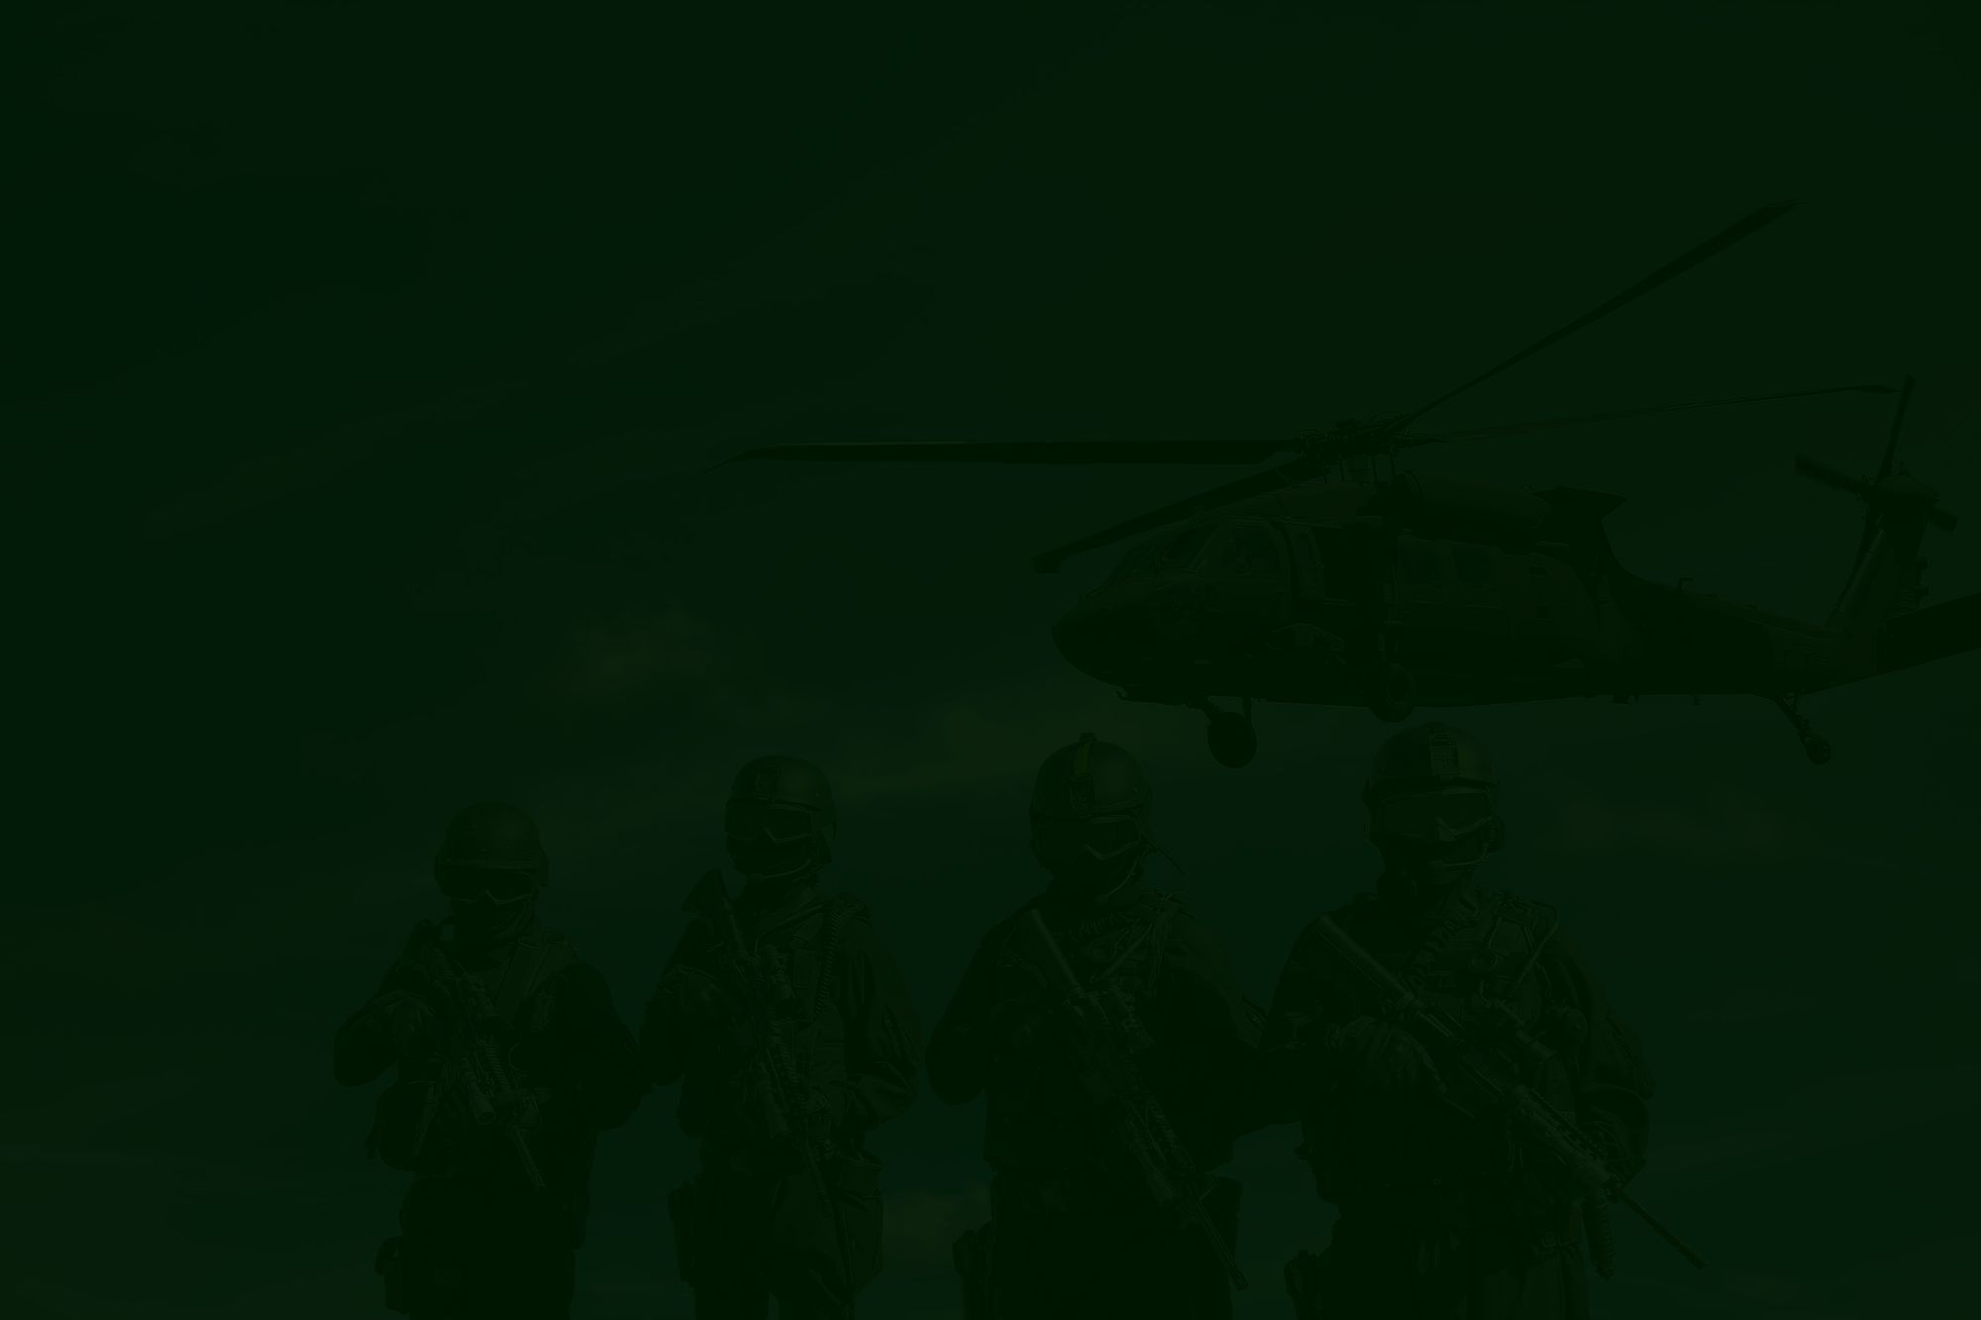

PROBLEM STATEMENT
Modern military operations often require silent and reliable communication between soldiers in the field.
Soldiers often face situations where noise discipline is critical, but still need to convey urgent tactical informations.
Voice communication risks detection of location during many situations where the soldier is hiding during a mission .
Hand signals are limited in range and visibility, especially in low-light or high-stress environments.
During intense battlefield situations filled with gunfire, explosions, and chaos, normal voice communication becomes impossible, making it hard for soldiers to coordinate effectively.

Slide 3
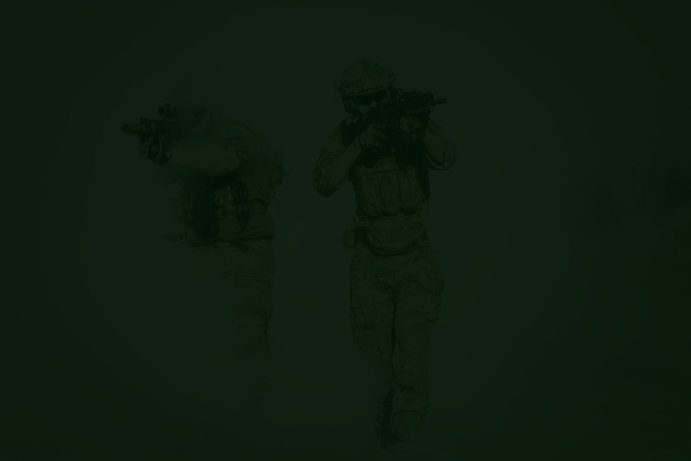
SilentLink
The language of silence in the battlefield.

Slide 4
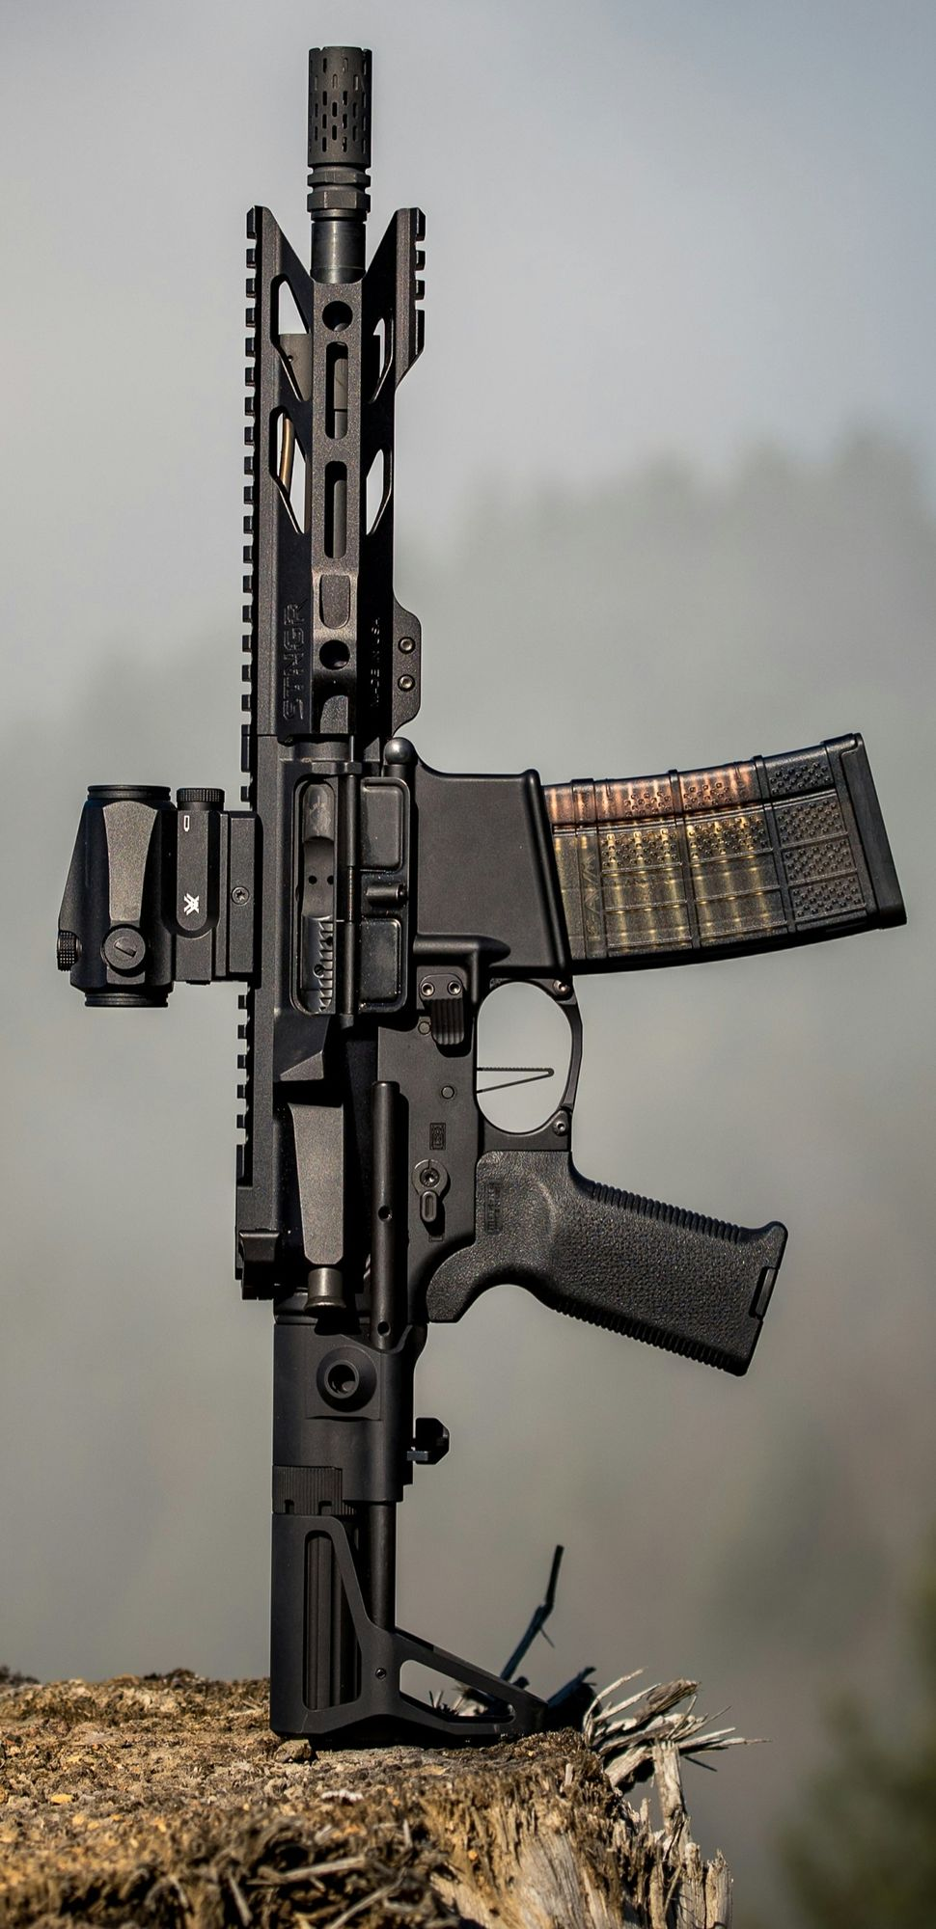
Product description
Dash code buttons
SilentLink is an innovative noiseless communication system designed for military stealth operations where strict noise discipline is essential. It allows soldiers to exchange information silently and securely using a Dash-code input button seamlessly integrated into their equipment.
The system converts Dash-code messages into plain text and instantly transfers them to teammates’ wristband displays for quick communication. At the same time, all exchanges between team members are mirrored on the commander’s dashboard, enabling real-time monitoring and oversight.

Slide 5
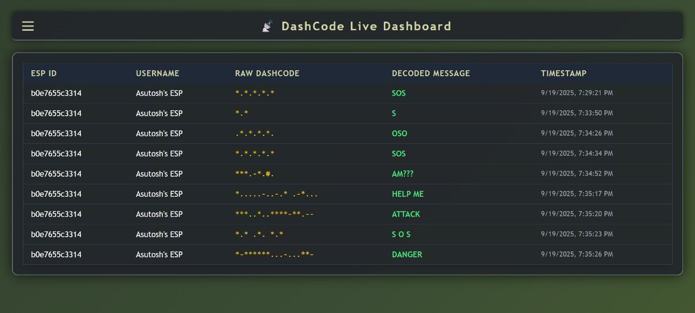
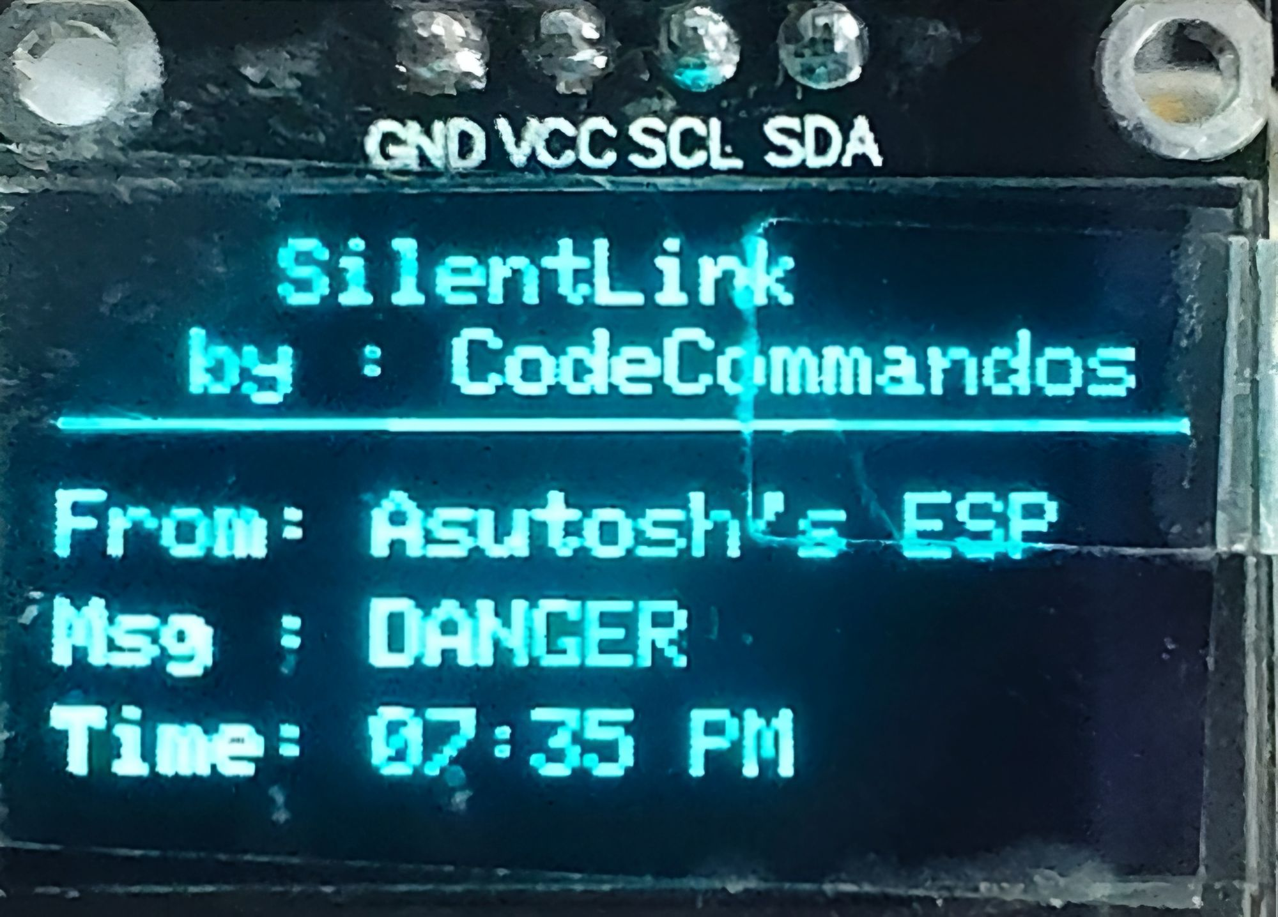
Key Features & Capabilities
Silent Communication – Dash-code button enables soldiers to send messages without making noise.
Smartband Integration – Team members instantly receive decoded text messages on their wrist devices.
Real-time Dashboard – Decodes Dash-code into plain text for commanders to monitor troop communication.
Two modes : a Dash-Mode for transmitting full text messages, and a Fast-Mode for sending urgent short signals with just one or two quick taps.

Slide 6

Use case scenarios
In many scenarios , soldiers cannot communicate through voice, and that is where SilentLink comes into play.
When a soldier is trapped during a mission and can’t communicate cause the sound will reveal him to the enemies.
When the poisonous gas is applied and soldiers have to wear the gas mask then communication breaks .

Slide 7

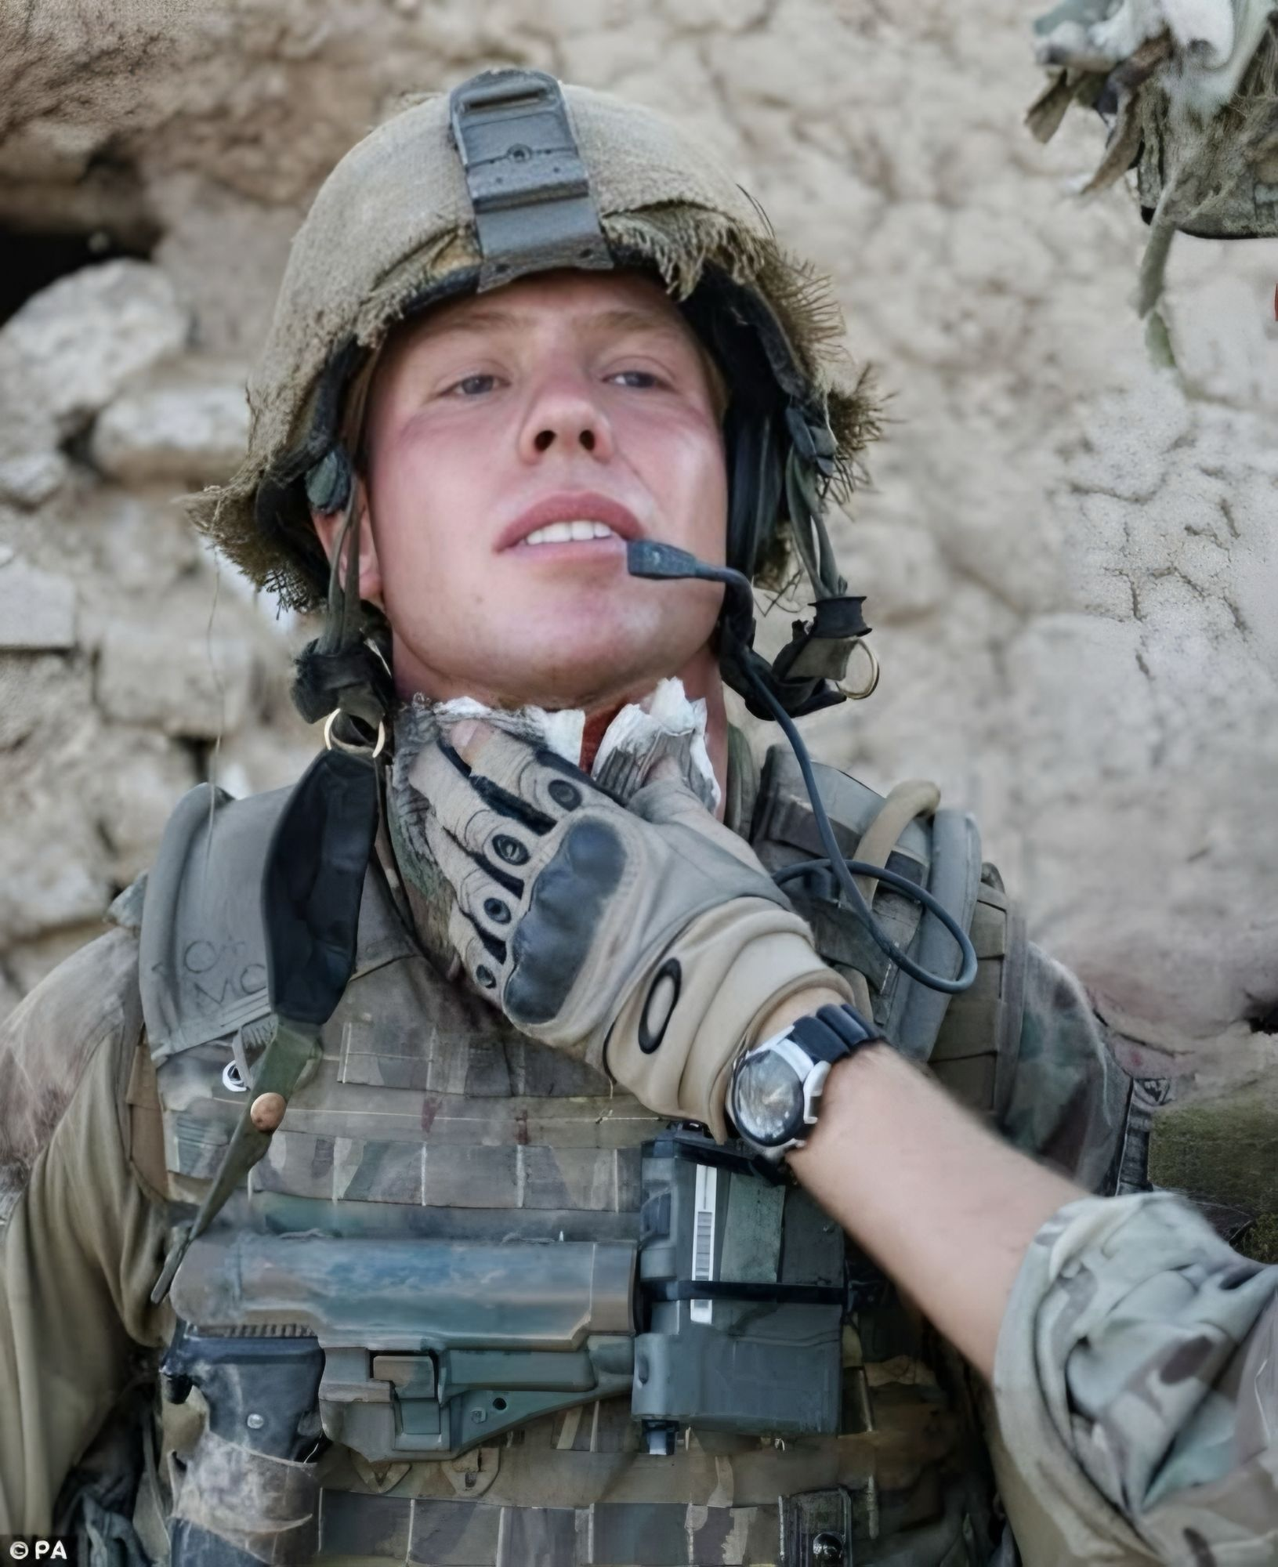

During severe injury if throat or jaw is injured soldier can’t speak but still can press a button for seeking help .
It enables military snipers to exchange critical information silently and instantly, ensuring they stay fully focused on the target.

Slide 8
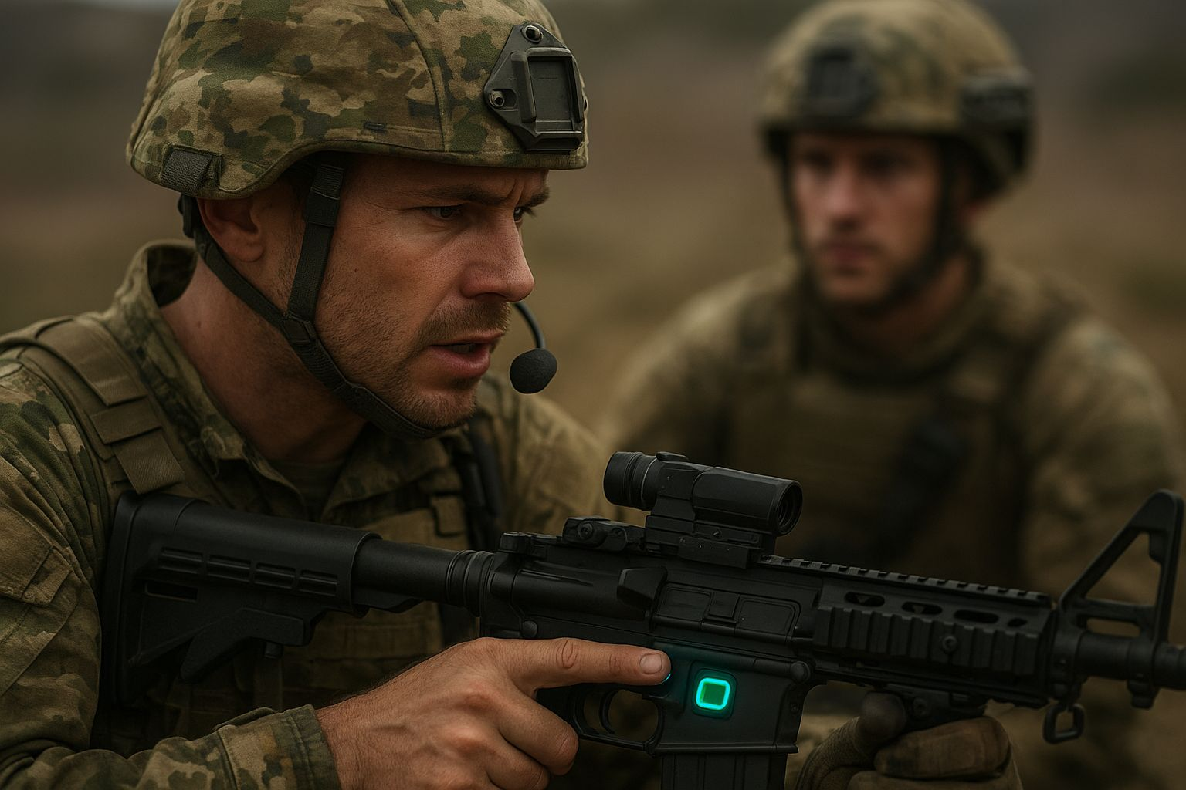
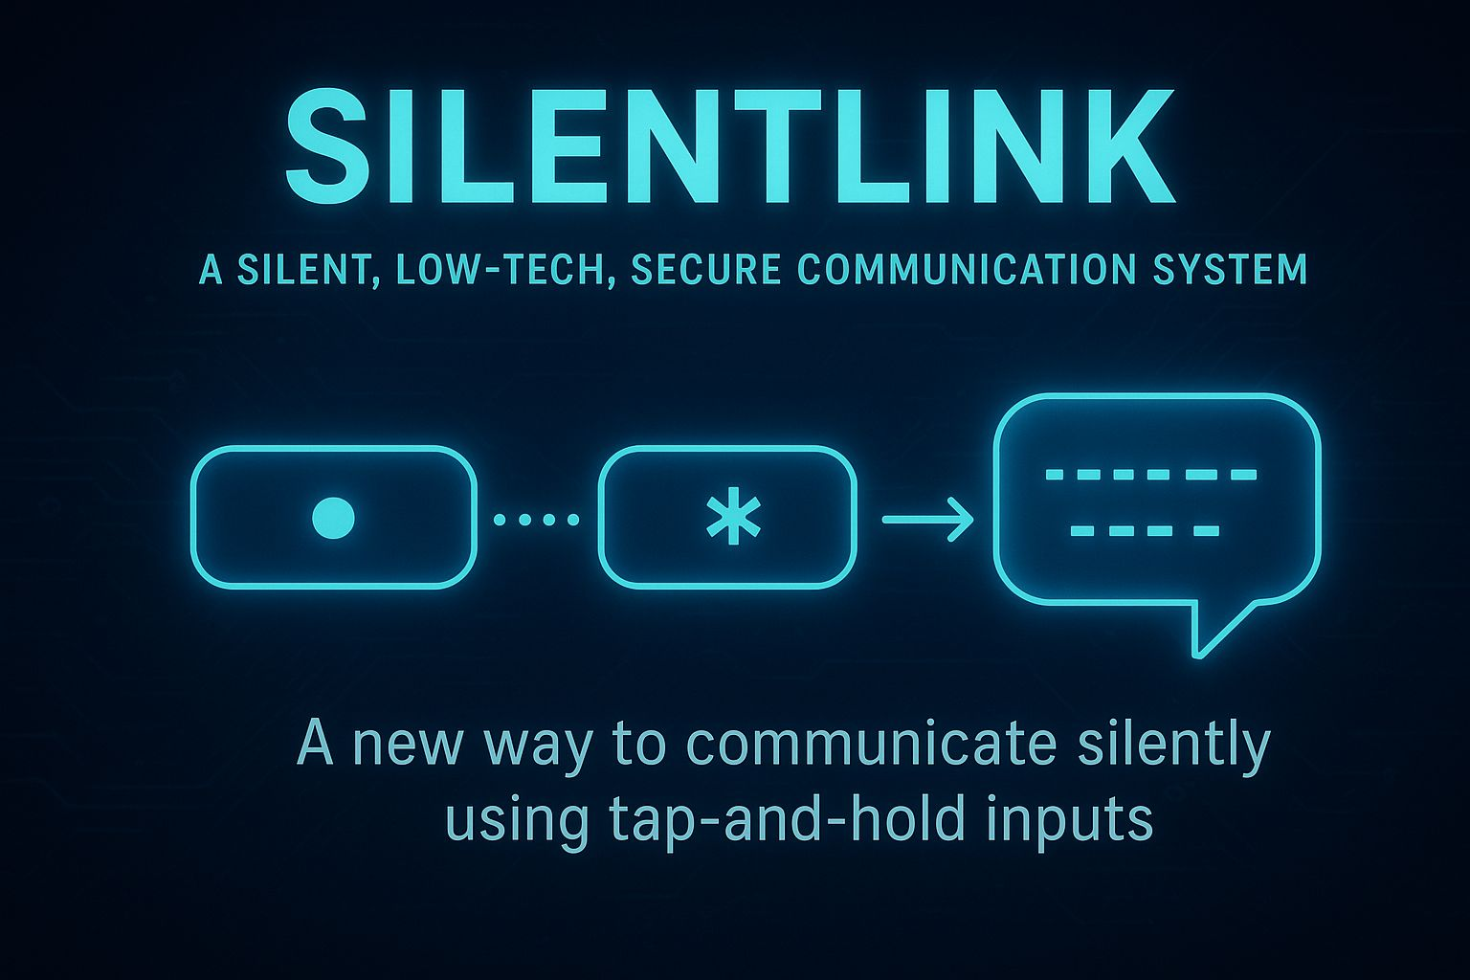
Impact & Benefits
Enhanced Soldier Safety – Enables silent communication, reducing the risk of enemy detection.
Reliable Communication – Works in noisy environments and during radio jamming.
Better Team Coordination – Smartwatch messages keep every soldier instantly updated.
Mission Success – Increases effectiveness of stealth and tactical operations.
Low-Cost & Portable – Lightweight setup that can be easily deployed in the field.
Scalable System – Can connect multiple soldiers and integrate with commander dashboards.
Advance Code - Dash-code is a faster code than morse code . It also offers greater security, as it is not standardized, making interception and decoding far more difficult . It is 3X faster than morse code .

Slide 9
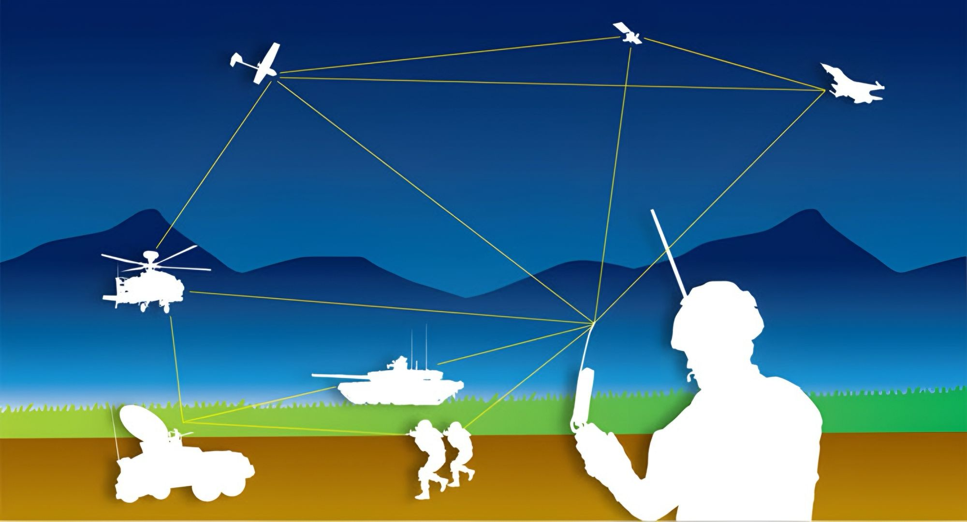
Future Scope
AI-Powered Translation – Automatic detection of custom soldier signals if typed wrong.
Advanced Smartwatch Integration – Voice-to-code fallback and health monitoring in the same device.
Satellite/UAV Relay – Extended communication range for remote missions.
Military-Grade Encryption – Stronger security against advanced interception.
Multi-Language Support – Messages auto-translated for international forces.
Conclusion
With Silentlink , we are not just eliminating noise . We are weaponizing Silence .

Slide 10
THANK YOU

Slide 11

DASH CODE
Dash Code is an experimental communication method created by our team for research and demonstration in this hackathon. It is designed to be faster, easier to learn, and more practical for silent or low-tech communication, especially in situations where quick information sharing is critical . It is not an officially recognized standard .
Dash Code operates with two buttons: pressing the left button gives “.” (dot), holding it gives “–” (dash) pressing the right button gives “*”, and holding it gives “#”. To create a space between words, both buttons are pressed simultaneously.
A ***
B -*.
C -**
D -
E ...
F *.-
G ..-
H *..
I .**
J --.
K .--
L -..
M .-*
N **.
O .*.
P -.*
Q *--
R **-
S .
T ..*
U .*-
V -.-
W *-.
X -*-
Y .-.
0 ---
1 #..
2 #.*
3 #*.
4 #**
5 #--
6 #-.
7 #.-
8 #*-
9 #-*
Z --*

Slide 12
